Slide 1
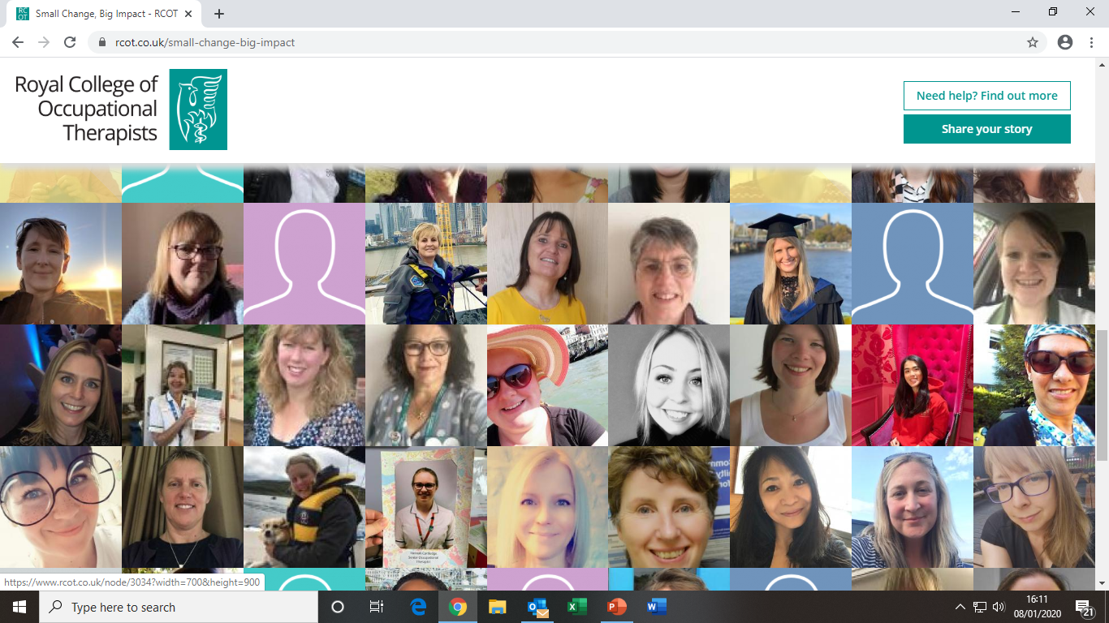
Notes:
RCOT year long campaign 2019-2020
Members share their stories digitally via the RCOT website
Inclusive and quick!

Slide 2
This session will include:
What is Small Change, Big Impact?
How to write your Small Change, Big Impact
How to upload your Small Change, Big Impact
How to share and promote your Small Change, Big Impact
Notes:
Its easy
Its quick
You can raise the profile of your organisation and highlight the achievements (impact) of your practice

Slide 3
Key facts
Year long campaign
Launched during Occupational Therapy Week 2019
To collect members’ stories, where a small change has a big impact
Over 600 received to date
Members share their story
RCOT uses stories with stakeholders
Monthly topics and a monthly star prize story
Involves members
Raises the profile of the profession
Notes:
Campaign will run a year – from November 2019 to October 2020
All members can take part – it doesn’t matter what your level of experience is
Stories can be:
Related to your practice
Related to your service
Related to your CPD
Related to your research
Monthly topics promoted in highlight and on social media
Monthly star story with prize

Slide 4
Occupational therapy week 2019
Notes:
Some key stats from occupational therapy week 2019 about the campaign
Ask attendees what did they do for Occupational Therapy Week
Did they see the campaign promoted by RCOT
Did they get involved
These stats show it was
Popular with members – the most members engaged in Occupational Therapy Week to date
Numbers are impressive – high engagement
The wall is quick and easy to share with others
Raising the profile of the profession amongst many stakeholders

Slide 5
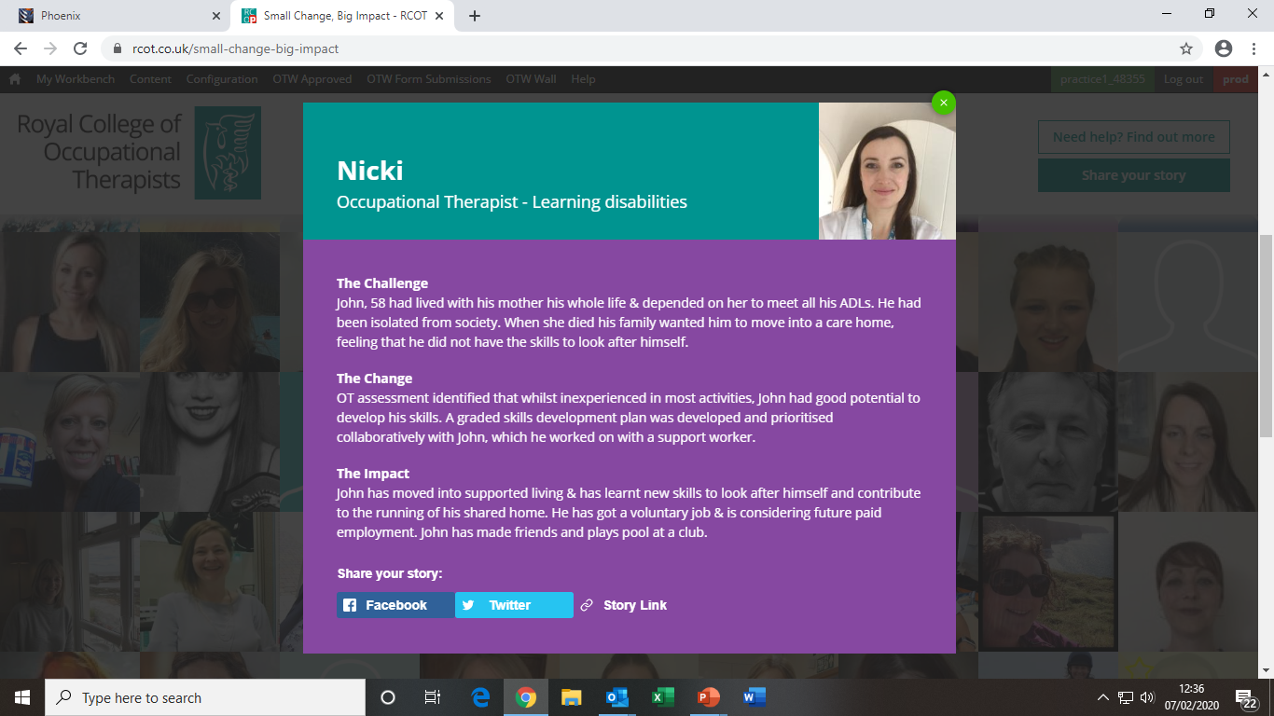
How to get involved
We are asking members to complete two easy actions:
Submit your Small Change, Big Impact story. Use the tips, guides and examples to tell your story.
Share your story with colleagues and wider audiences to promote your achievements and the profession, once it’s been published on the wall.
Notes:
There is an interactive wall all to help members be part of the campaign. This is building up a picture of practice throughout the UK and everyone can be a part of it.
Its easy to get involved
Submit your story – there are resources to help you at this link
Share your story – this can be with your colleagues, managers, other health professionals, your comms team, your family and friends, your local politicians via social media, email and in your workplaces

Slide 6
The story gathering questions are:
What was the challenge?
What did you change?
What was the impact?
Stories can be:
Individual
Team
Service
TASK: Work in teams to write a Small Change, Big Impact
Notes:
Go through the next few slides and then work in small groups to write a small change big impact
Think about the questions
Three easy steps
Stories can be about CPD, research as well as practice

Slide 7
Tips
1. Keep them short - 25 – 30 words
2. Don’t use real names, organisation names, jargon or acronyms
3. Be specific about the change and impact - not just the practical but what it meant to the person’s quality of life.
Resources for telling your story
Guide - Share your Small Change, Big Impact story (PDF, 120.18KB)
Guide - How to write your Small Change, Big Impact story (PDF, 116.9KB)
Small Change, Big Impact example stories (PDF, 107.83KB)
Available at: https://www.rcot.co.uk/promoting-occupational-therapy/small-change-big-impact-about-campaign
Stories can be:
Personal
Team
Service
Notes:
Some tips to keep in mind
Demonstrate the value of the change in the impact
Further resources are available on the website
There are three examples on the next slides to chat through to give you ideas
You can also open the wall if you’re able to show some examples to see the range that have been submitted https://www.rcot.co.uk/small-change-big-impact
And/or encourage people to look at the wall on their phones while doing the task

Slide 8
Examples
What was the challenge?
Shannon was having up to three panic attacks in school a day. These were impacting on her ability to engage in class.
What did you change?
I taught Shannon mindfulness and breathing techniques to integrate into her daily routine.
What impact did you make?
Shannon’s panic attacks stopped and were no longer a barrier to her participation in class.
Notes:
Individual example – how a member has worked with a person and make a big impact from a small change

Slide 9
Examples
What was the challenge?
There were a large number of older people calling 999 and being taken by ambulance to the emergency department following a fall.
What did you change?
Introduced a dedicated falls response team to attend to 999 calls with an occupational therapist and paramedic working together to keep people at home.
What impact did you make?
86% of the people visited remained at home which was better for them and led to significant financial savings.
Notes:
Service example – an example from a service – they made a small change – where occupational therapists were deployed which has had a big impact for their service users

Slide 10
Examples
What was the challenge?
Ron has dementia and while he was in hospital it was decided that he needed 24 hour residential care as his symptoms worsened. Ron and his family were not happy about this.
What did you change?
I worked with Ron and his family at home to rely less on carers – this included introducing door sensors.
What impact did you make?
Ron has improved so much he is managing at home with only 2 x 45 minutes of care per day and has even started to go the pub.
Notes:
Individual example

Slide 11
TASK: Work in teams to write a Small Change, Big impact
Notes:
Time for people to write their story – in groups or on their own, using the information gained on the previous slides

Slide 12
Group feedback to the main group
Notes:
Feedback to main group
What works well?
How did it go?
How did you find writing the impact section
How did you find writing in a non clinical way
You can also open the wall if you’re able to show some examples to see the range that have been submitted https://www.rcot.co.uk/small-change-big-impact
And/or encourage people to look at the wall on their phones for comparisons

Slide 13
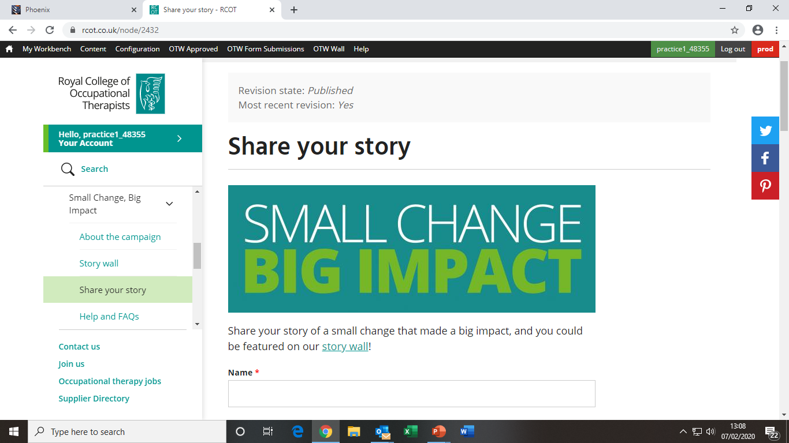
Upload your story now
Go to: ‘Share your story’ https://www.rcot.co.uk/node/2432
Complete the online form.
You will need your:
Name and contact details
RCOT number
A photo – optional
Notes:
Now time to upload the story
Its easy – go to the link and complete the simple form
Be aware that each question has a limit of 250 characters for the its answer. This includes punctuation and spaces!
Encourage people to add photos – the wall looks great with so many faces
Once submitted RCOT will send an automatic confirmation
This will be followed by a further email once the story has been approved and is live on the wall.
If RCOT know about your event they will prioritise approval so attendees can share their stories quickly

Slide 14
Share your story with colleagues and wider audiences to promote your achievements and the profession, once it’s been published on the wall.
Share on social media and email from your example online
Notes:
This shows how to share your story directly from the story wall
You can do this once your story has been approved
Tag RCOT in your social media sharing

Slide 15
Promoting your story and the profession
Use your story to promote the unique value and impact of occupational therapy. Again small actions can make a big impact.
Post your story on social media using #SmallChangeBigImpact and tag RCOT.
Download our poster template, add your story and display it at work.
Encourage your fellow members to share their Small Change, Big Impact story on the wall and with wider audiences.
Use our campaign graphic to promote the Small Change, Big Impact campaign on social media.
Resources available online*
* https://www.rcot.co.uk/promoting-occupational-therapy/small-change-big-impact-about-campaign
Notes:
These are quick and easy ways to share your story.
Use the RCOT resources to help you
You can finish the session here and go to the last two slides.
If you want to do a bit more on promoting your story move onto the next slides

Slide 16
More on promoting your story
Notes:
Beginning of optional section

Slide 17
Telling your story…..write, record, film
Practice telling your story to each other
Record your story on your phone
Know it inside out and back to front!
What makes it specifically occupational therapy??
Notes:
Encourage attendees to tell their story to each other
Questions they can consider when feeding back
Is it clear
Does it make sense
Does the impact stand out
Encourage people to record or film on their phone
If stories have been approved then encourage people to share on social media
If stories have yet to be approved perhaps direct attendees to the RCOT twitter account and encourage them to retweet a relevant tweet with a message

Slide 18
Where are your opportunities to talk about your story?
Think about your opportunities – feedback to the rest of the group
Notes:
Have a bit of a brainstorm, where can people talk about their story, in what other ways can they promote it
Then see how this compares to the suggestions on the next slide

Slide 19
Where are your opportunities to talk about your story?
PEOPLE
Other occupational therapists – raise awareness of the campaign
Other colleagues, team members, managers, senior managers
Your communications team – can they help you promote it?
With people using your service
WHERE
In team meetings
On notice boards
CPD sessions
On social media
In newsletters / your organisation’s communication team
During any development sessions
Notes:
Suggestions of where to share stories – how does this compare with the groups ideas?

Slide 20
We have covered:
What is Small Change, Big Impact?
How to write your Small Change, Big Impact
How to upload your Small Change, Big Impact
How to share and promote your Small Change, Big Impact
Notes:
Quick summary
Get some feedback
What did people think?

Slide 21
What’s next?
Enjoy telling your story
Don’t forget to let RCOT know about your successes and results
Feedback to your branch or to Clare.Leggett@rcot.co.uk Stacey.Abraham@rcot.co.uk
Notes:
Do let RCOT know either through your region or specialist section how your small change big impact has been received
Or contact RCOT with successes and results – clare.Leggett@rcot.co.uk or Stacey.Abraham.rcot.co.uk
We’d love to hear how you got on, especially any significant successes or different ideas that have worked

