Slide 1
Royal College of Occupational Therapists
Strategic Intentions & pledge campaign
www.rcot.co.uk

Slide 2
Agenda
Reminder of the Strategic Intentions
Why do we have them?
Why pledges?
Launching the pledge campaign
RCOT pledges
Member pledges
Get involved
www.rcot.co.uk

Slide 3
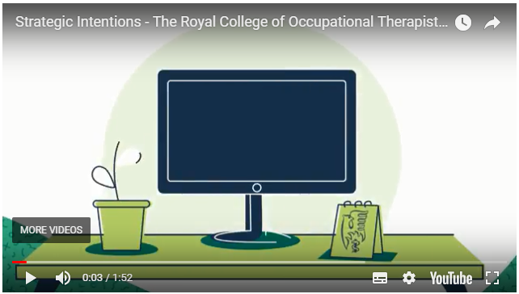
The Strategic Intentions
www.rcot.co.uk

Slide 4
Why does RCOT have Strategic Intentions?
Demonstrate leadership
To shape RCOT’s response to changes in health and social care
To raise the profile of occupational therapy and its value to UK citizens
Provide a framework to support members and the wider profession
Secure the future of the profession
www.rcot.co.uk

Slide 5
Why pledges?
To ensure new Strategic Intentions are not just ‘internal’
RCOT needs the commitment of all its stakeholders, but especially members, in order to achieve its Strategic Intentions
Pledge campaign asks individuals or groups to set a goal or make a commitment – their pledge
Combined, the pledges will comprise RCOT’s journey towards achieving its Strategic Intentions
The idea was developed with occupational therapists – the idea resonated with the occupational therapy approach – make a plan towards achieving a goal
www.rcot.co.uk

Slide 6
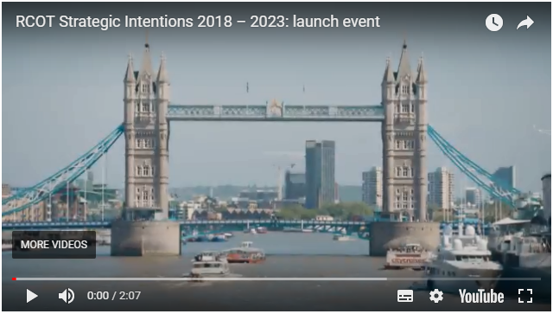
Launching the pledge campaign…
https://youtu.be/O8KLl6Wx6_k
www.rcot.co.uk

Slide 7
We made some pledges of our own:
RCOT pledges to encourage innovative cutting edge occupational therapy theory and practice. (Position the profession, and our members, for the 21st Century)
RCOT pledges to influence decision-makers at the highest level to ensure that UK citizens have access to, and benefit from, high quality occupational therapy services. (Enhance the profile of the profession to a range of audiences)
RCOT pledges to promote occupational therapy through activities such as conference speaking and working with the media. (Enhance the profile of the profession to a range of audiences)
RCOT pledges to offer the very best service to its members through ongoing development of member benefits. (Ensure RCOT is a thriving membership organisation within which members flourish)
www.rcot.co.uk

Slide 8
Member pledges so far…
The pledges….
Value of occupational therapy
Learning, knowledge sharing & CPD
Defining and claiming occupation
Small, yet vital contributions – I will tweet more!!
www.rcot.co.uk

Slide 9
Why is it important we identify themes…
Understand what is important to our members
Ensure we are providing the right support & resources to help them achieve their pledge
Identify areas where we need to provide more support to members to encourage more pledges in a certain area – i.e. leadership
www.rcot.co.uk

Slide 10
How can you get involved?
Tell us what you think!
What can we do to keep the campaign fresh & appealing to members?
What can we do to make it appealing to other stakeholders?
Make a pledge!
www.rcot.co.uk

Slide 11
How can you get involved?
www.rcot.co.uk

Slide 12
Thank you!
www.rcot.co.uk

